Slide 1
DEVELOPING A RESEARCH PLAN
DR. KIMBERLY D. KENDRICKS USTARS EARLY CAREER FACULTY DEVELOPMENT WORKSHOP SAM HOUSTON STATE UNIVERSITY APRIL 15, 2016

Slide 2
RESEARCH TOPICS
PAST EXPERIENCE
DISSERTATION
FACULTY ADVISOR/ RESEARCH MENTOR
CONCEPT MAP

Slide 3
GOALS
SEE HANDOUT – “DEVELOP YOUR SUCCESS PLAN” CALIFORNIA STATE UNIVERSITY, SCHOLAR COMMONS

Slide 4
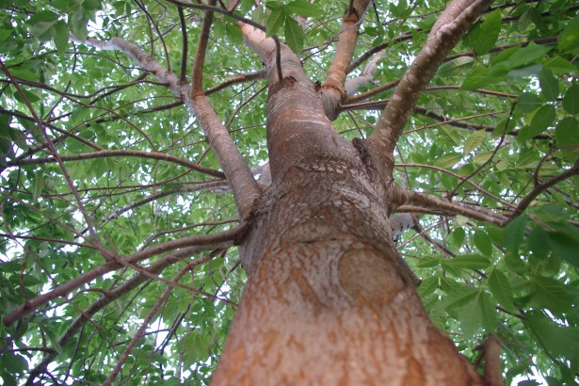
KEEP IN MIND
THEMATIC
MANY OPPORTUNITIES STEM FROM ONE PROJECT
CREATE TIERS OF PEER-REVIEWED JOURNALS

Slide 5
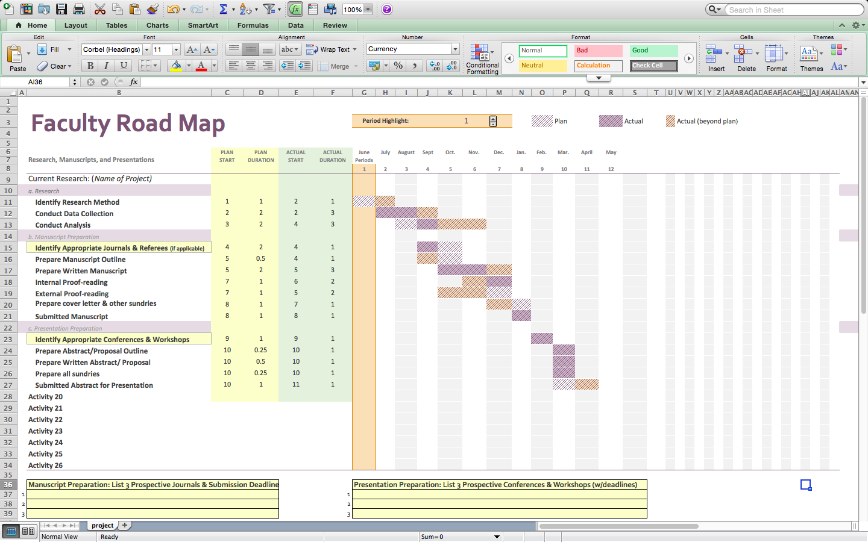
PRODUCTIVITY TRACKING SYSTEM
COLUMNS - MONTH (LEAVE 4 COLUMNS BLANK)
ROWS- LIST EACH RESEARCH ACTIVITY
CODING
R = RESEARCH )
W=WRITING
U = UNDER REVIEW
P = PUBLISHING
SCHEDULING TIME IN YOUR CALENDAR

Slide 6
IMPORTANT TAKE-AWAYS
ACKNOWLEDGE YOUR TRUE INTERESTS/PASSIONS
STAY THE COURSE OF YOUR RESEARCH PLAN
MAKE TIME FOR YOURSELF; PROTECT YOUR PRODUCTIVITY!
POST YOUR LONG TERM GOALS ON YOUR DESK AS A REMINDER

Slide 7
FINDING FUNDING FOR UNDERGRADUATE RESEARCH WITH UNDERREPRESENTED STUDENTS

Slide 8
MATH ORGANIZATIONS
MAA’S NATIONAL RESEARCH EXPERIENCES FOR UNDERGRADUATES PROGRAM (NREUP)
HELD ANNUALLY; DEADLINE: LAST FRIDAY IN FEBRUARY
BUDGET: $27,500 (FACULTY STIPEND $5,500; STUDENT STIPEND + PLUS ROOM AND BOARD, SUPPLIES)
MINIMUM OF FOUR PARTICIPANTS
RESEARCH DURATION: 6-1O WEEKS
POC: OLGA DIXON, ODIXON@MAA.ORG, 202-319-8498
BRIGHAM YOUNG UNIVERSITY
HELD ANNUALLY; DEADLINE: MID-NOVEMBER
BUDGET: $12,000-$25,000 (FACULTY STIPEND $6,000; STUDENT STIPEND $3,000, TRAVEL, SUPPLIES)
MINIMUM OF TWO PARTICIPANTS (2-5 PER FACULTY MEMBER)
FACULTY RESEARCH WORKSHOP
POC: MICHAEL DORFF, MDORFF@MATHEMATICS.BYU.EDU, 801-422-1752

Slide 9
NATIONAL PROGRAMS (for Undergraduates)
RESEARCH EXPERIENCES FOR UNDERGRADUATES (VISIT WWW.THELEADERSHIPALLIANCE.ORG)
MATHEMATICAL SCIENCES RESEARCH INSTITUTE (UNIVERSITY OF CALIFORNIA, BERKELEY)
BIOSTATISTICS ENRICHMENT TRAINING DIVERSITY PROGRAM (COLUMBIA UNIVERSITY)
MATHEMATICAL AND THEORETICAL BIOLOGY INSTITUTE (ARIZONA STATE UNIVERSITY)
SUMMER PROGRAM TO INCREASE DIVERSITY IN UNDERGRADUATE RESEARCH (UNIVERSITY OF NORTH CAROLINA, CHARLOTTE)
XSEDE SCHOLARS PROGRAM (RICE UNIVERSITY)

Slide 10
NATIONAL PROGRAMS (for graduates)
MATHEMATICAL SCIENCES RESEARCH INSTITUTE (UNIVERSITY OF CALIFORNIA, BERKELEY)
NATIONAL SECURITY AGENCY SUMMER PROGRAM FOR GRADUATE STUDENTS
NATIONAL SCIENCE FOUNDATION EAST ASIA AND PACIFIC SUMMER INSTITUTES PROGRAM
SCIENCE, MATHEMATICS, AND RESEARCH TRANSFORMATION EDUCATION PROGRAM (SMART PROGRAM)
NATIONAL SCIENCE FOUNDATION GRADAUTE RESEARCH FELLOWSHIP PROGRAM

Slide 11
OPPORTUNITIES BEYOND...
U.S. Department of Education
National Science Foundation (DMS, DUE, HRD)
Department of Energy
Naval Research Laboratory
Air Force Research Laboratory (American Society for Engineering Education)
University Technology Corporation Minority Leaders Program
National Security Agency Mathematical Sciences Program (Individual, Conferences, Sabbaticals, & REUs)
Department of Transportation
Institute for Educational Sciences

